Slide 1
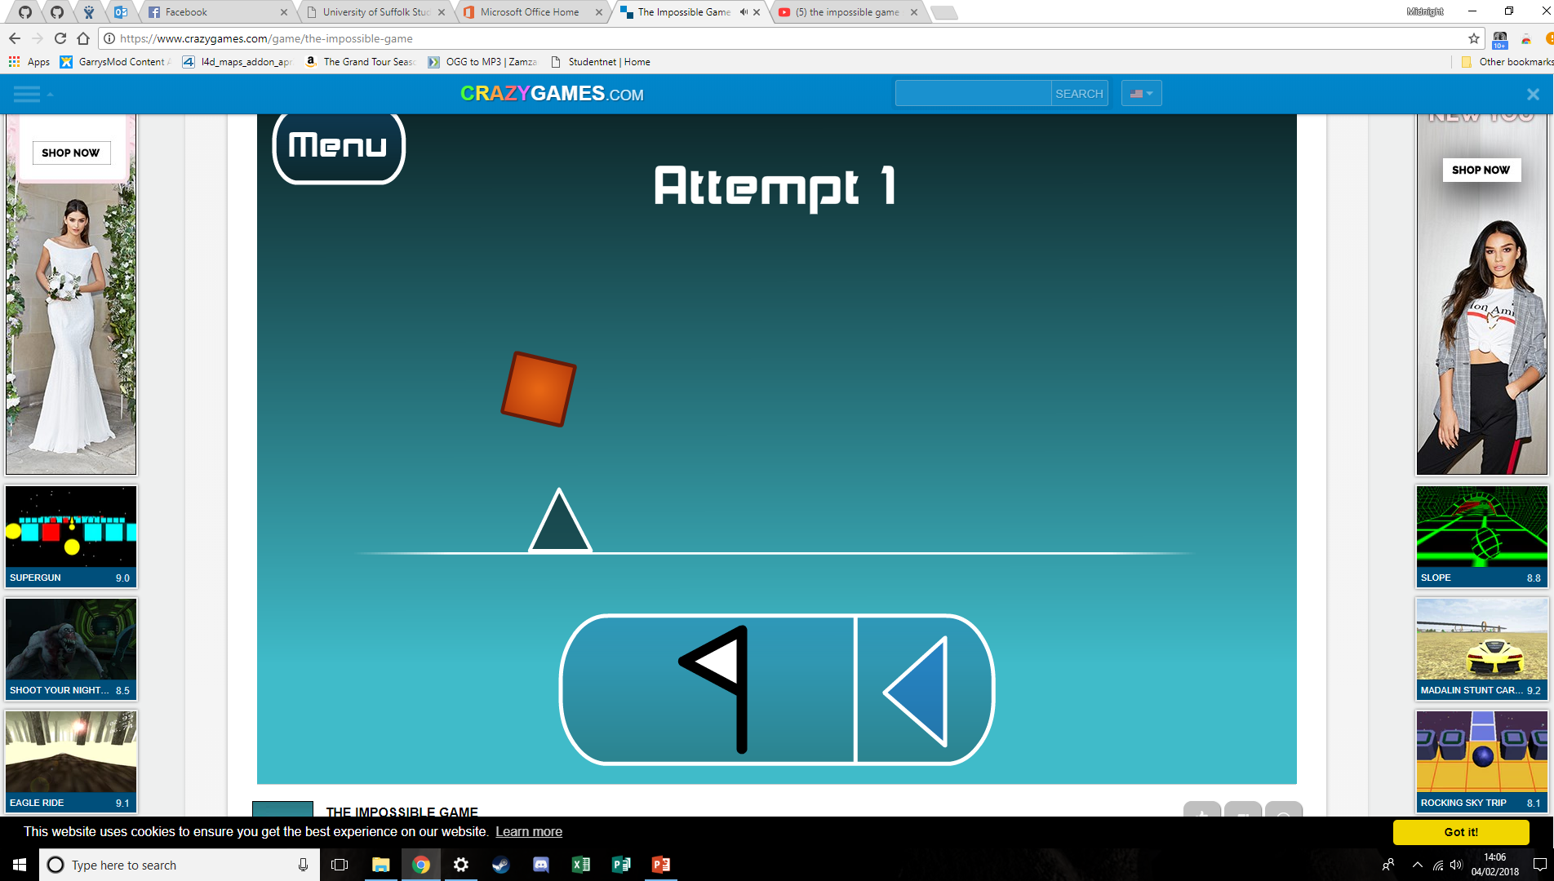
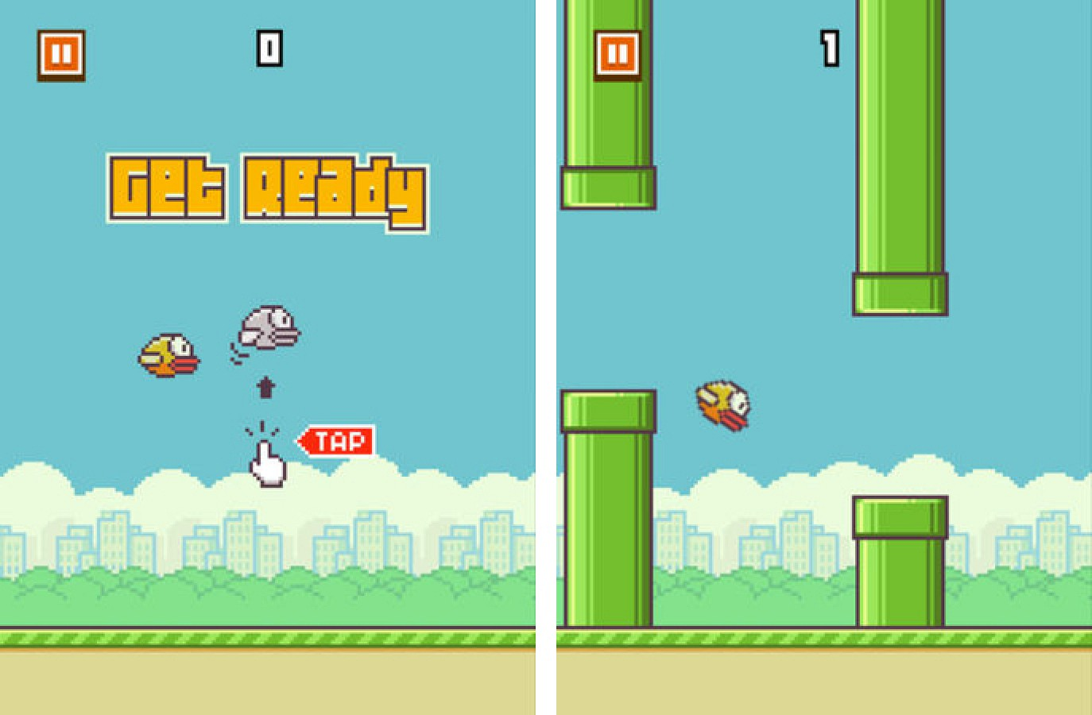
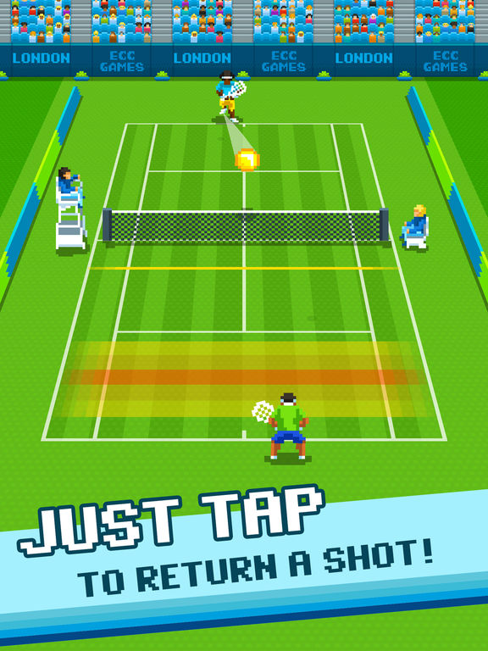
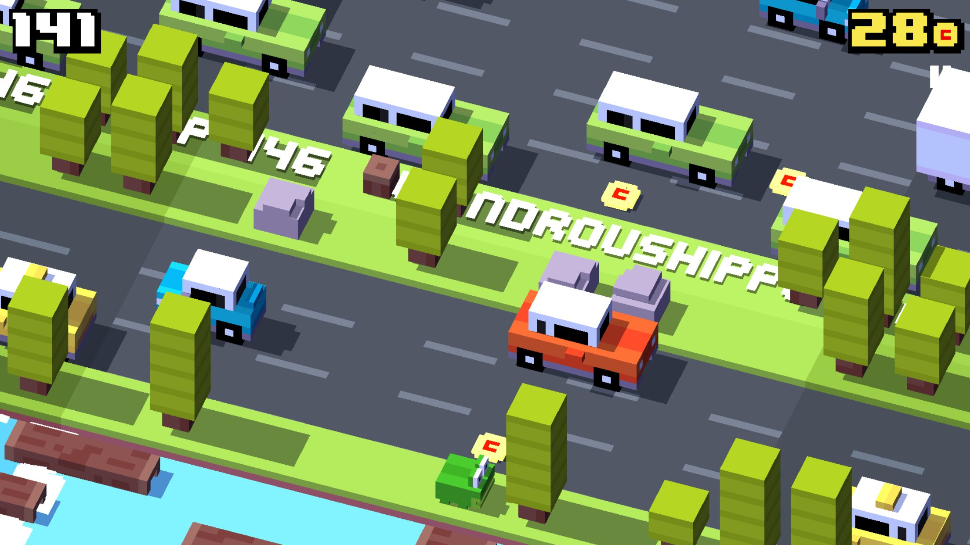
Jump Game
Next to no UI
(Flappy Birds)
(The Impossible Game)
Simple instructions with a simple premise
(https://play.google.com/store/apps/details?id=com.chillingo.onetaptennis.android.gplay&hl=en_GB)
3D modelling makes this game feel crowded and claustrophobic
(Crossy Road)

Slide 2
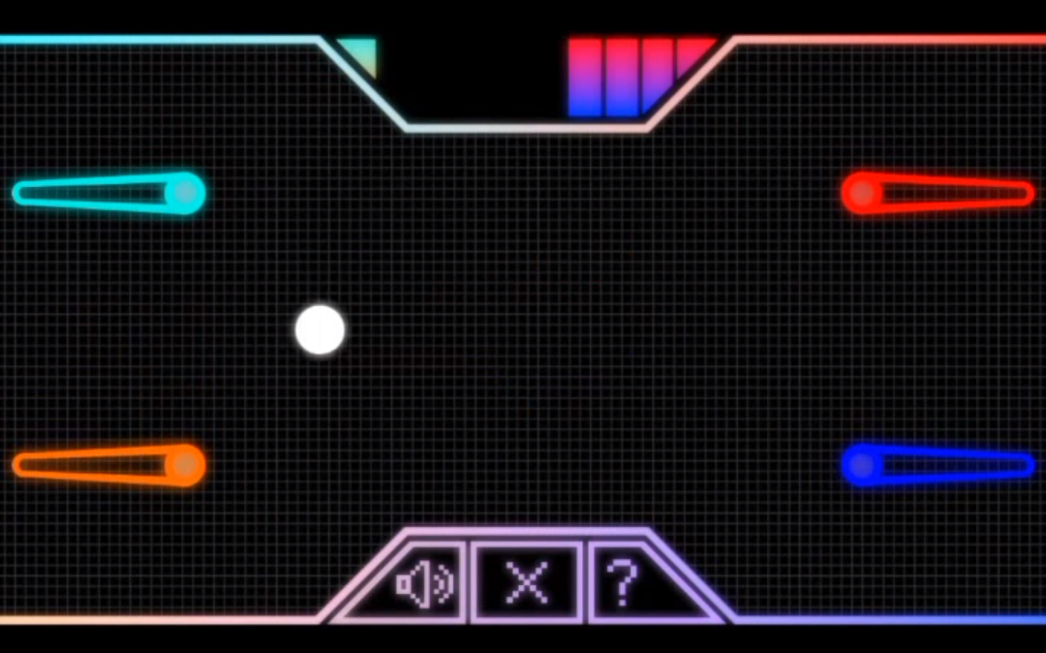
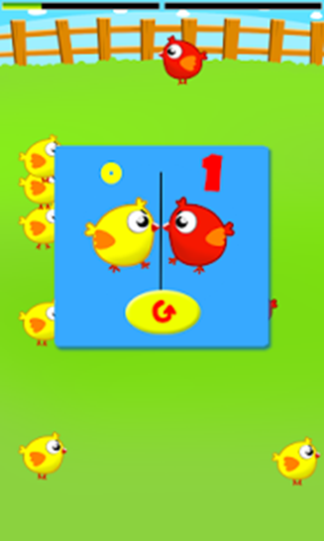


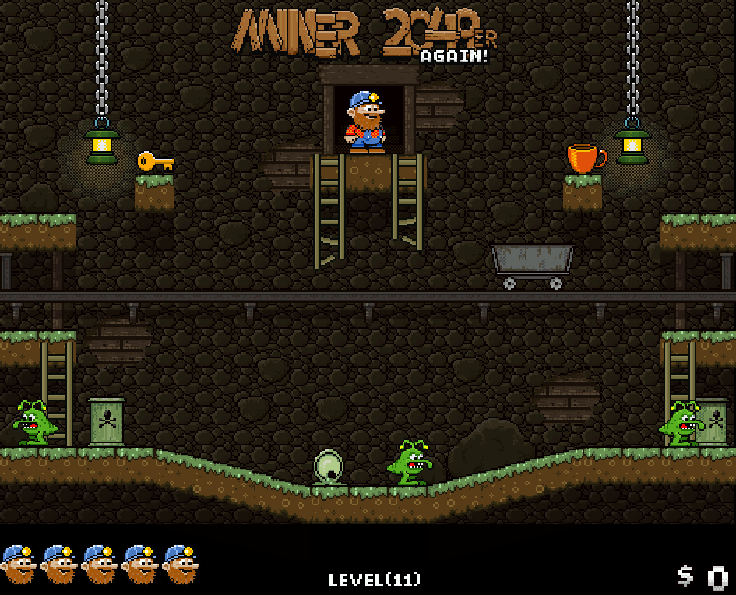
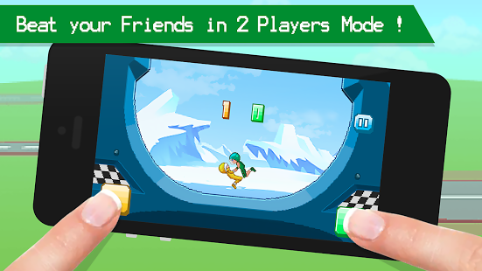
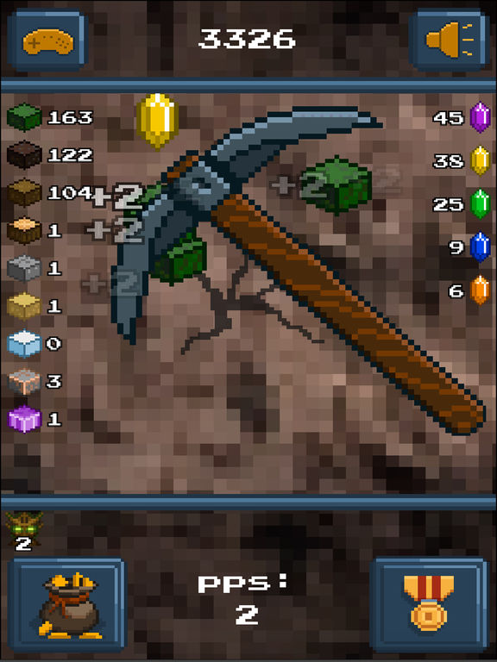
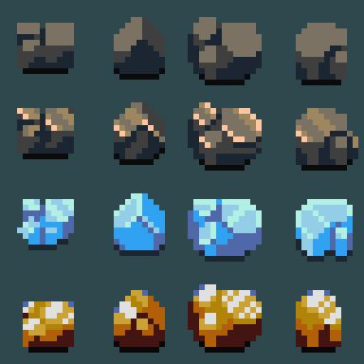
Mining Game
Simple level design, bare minimum
Simple scoring system
(https://play.google.com/store/apps/details?id=com.bbbbb.chikenwar&hl=en_GB)
Possible avatar choice
PinPong: 1-2 Players
https://play.google.com/store/apps/details?id=com.MatthewBurton.TwoPlayersOnly&hl=en_GB
Possible different rock designs when hit
Obvious one tap button controls
(Funny Wrestle - 2 Player Games)
https://play.google.com/store/apps/details?id=com.pnt.wrestlingmadness&hl=en_GB

Slide 3
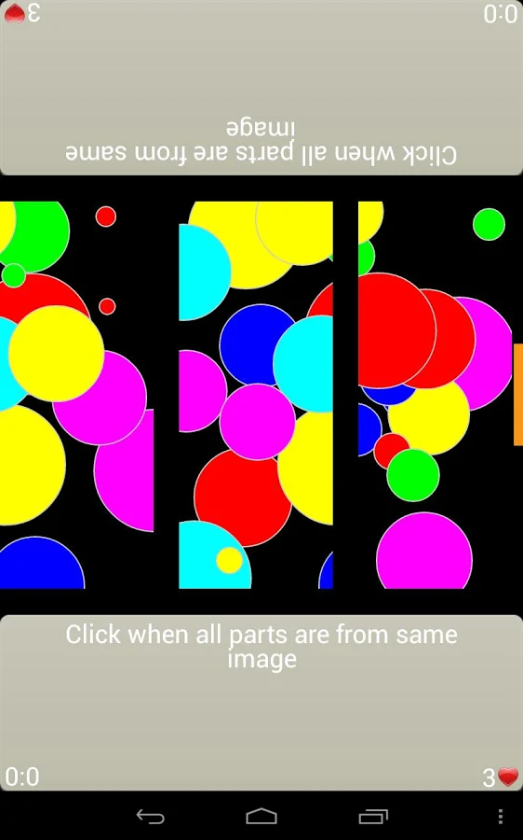
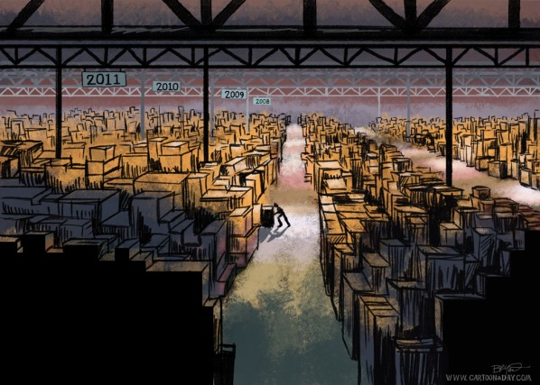
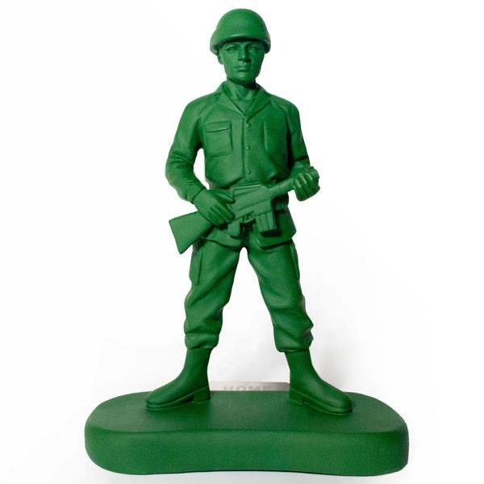


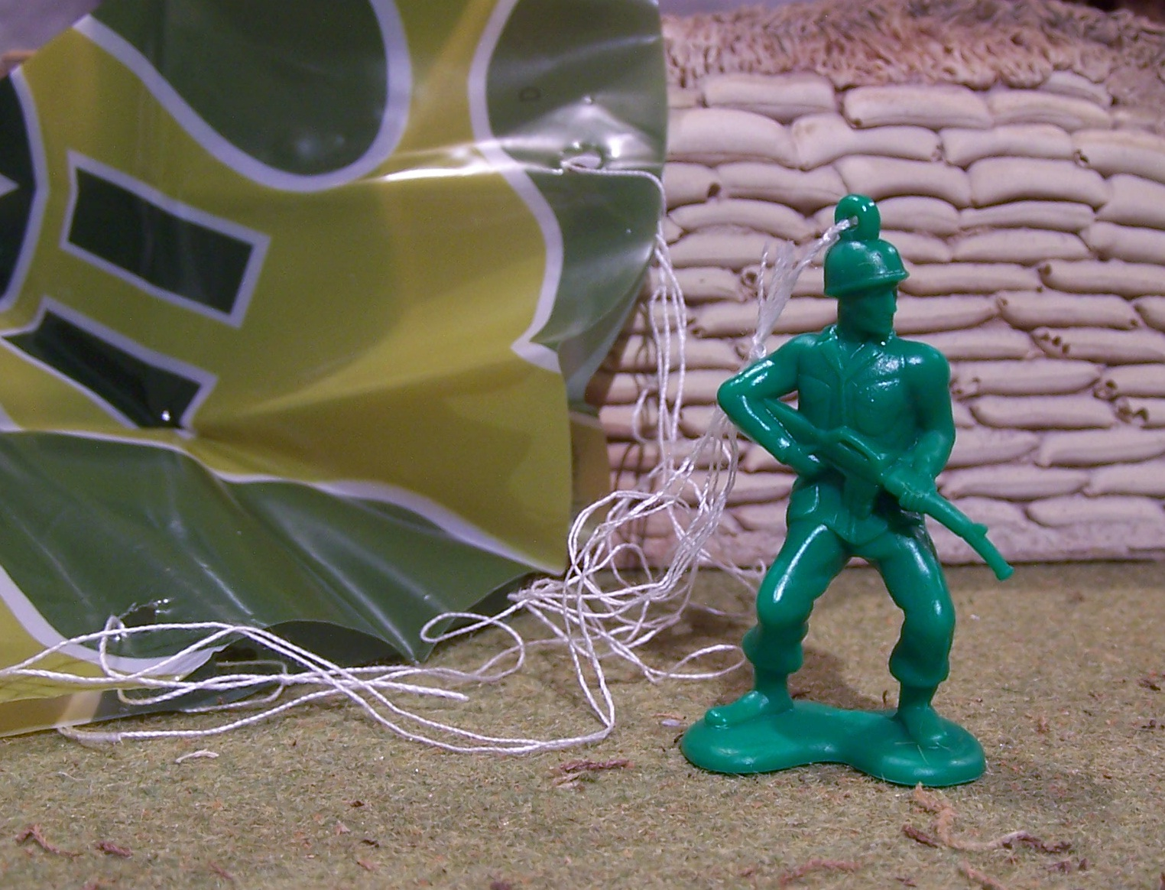

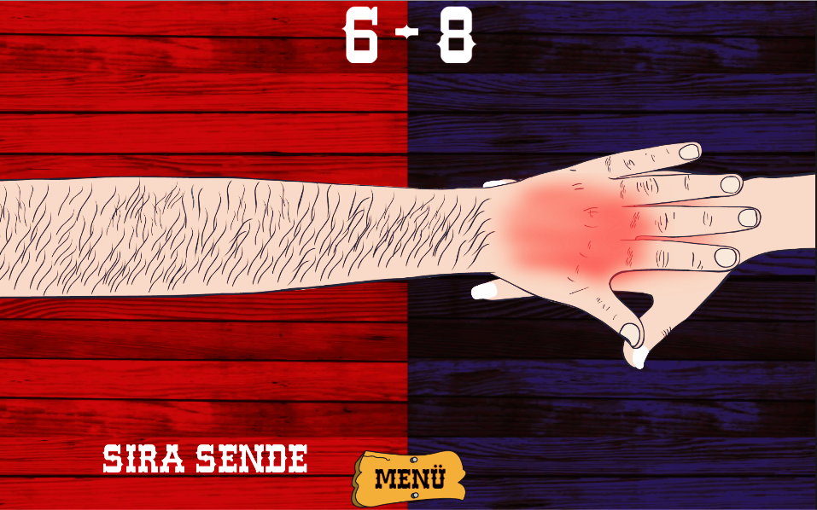
Parachuter
Requires simple knowledge, easy to understand
Background possible ideas
https://play.google.com/store/apps/details?id=com.blueinfinity.reactor&hl=en_GB
http://www.cartoonaday.com/irs-tax-forms-lost-ark-warehouse/
http://www.cartoonaday.com/irs-tax-forms-lost-ark-warehouse/
Reaction based, simple scoring system
https://play.google.com/store/apps/details?id=com.uzngames.handshot&hl=en_GB

